Slide 1

Corona Virus Analysis
By Vinutha Satish Mulik

Slide 2

Project Overview
The CORONA VIRUS pandemic has brought about unprecedented challenges to public health worldwide.
Data-driven insights are crucial in understanding the spread of the virus and guiding public health measures.
As a data analyst, this presentation aims to analyze a CORONA VIRUS dataset to derive meaningful insights and present findings.

Slide 3
Dataset Description
Description of each column in dataset:
Province: Geographic subdivision within a country/region.
Country_Region: Geographic entity where data is recorded.
Latitude: North-south position on Earth's surface.
Longitude: East-west position on Earth's surface.
Date: Recorded date of CORONA VIRUS data.
Confirmed: Number of diagnosed CORONA VIRUS cases.
Deaths: Number of CORONA VIRUS related deaths.
Recovered: Number of recovered CORONA VIRUS cases.

Slide 4

Data Exploration and Analysis

Slide 5

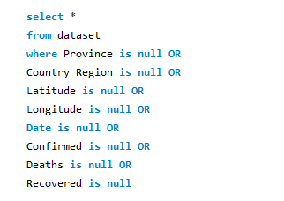
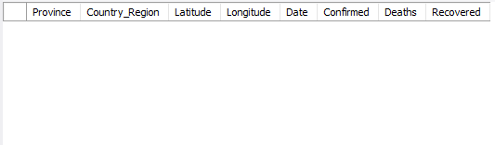
Check for NULL values
Data Quality Check

Slide 6
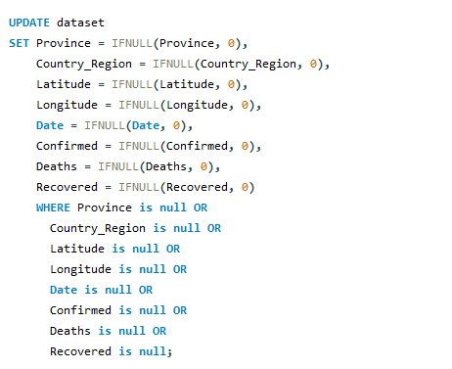
If NULL values are present, update them with zeros for all columns.
Data Quality Check

Slide 7


Total number of rows
Data Quality Check

Slide 8


Start_date and End_date
Data Analysis

Slide 9


Number of month present in dataset
Data Analysis

Slide 10
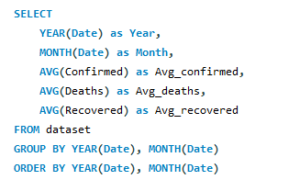
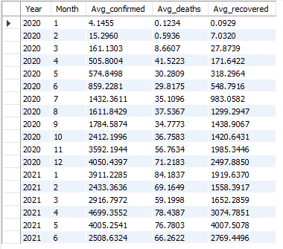
Monthly average for confirmed, deaths, recovered
Monthly Analysis

Slide 11
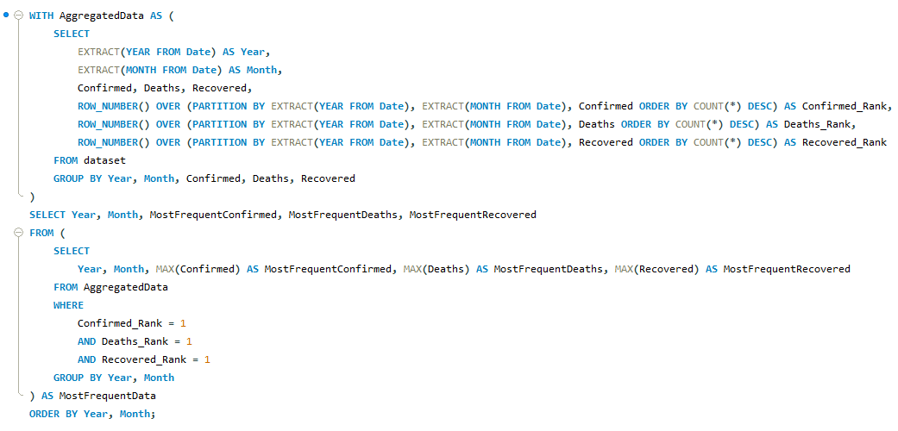
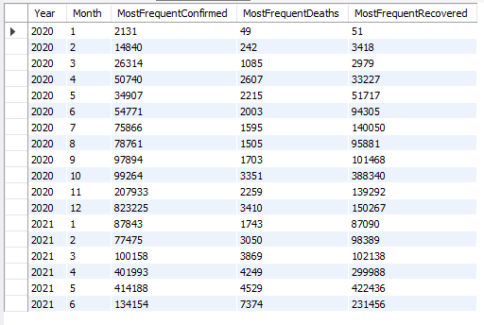
Most frequent value for confirmed, deaths, recovered each month

Slide 12
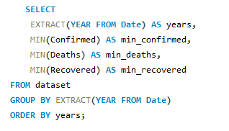

Minimum values for confirmed, deaths, recovered per year
Yearly Analysis

Slide 13
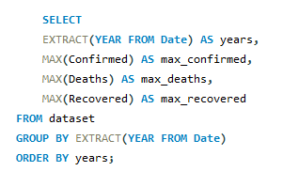

Maximum values of confirmed, deaths, recovered per year
Yearly Analysis

Slide 14
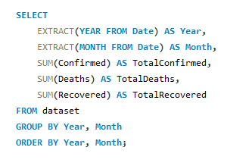
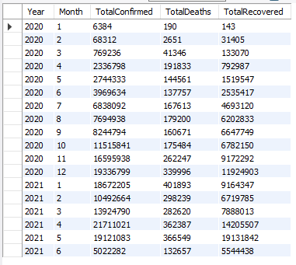
The total number of case of confirmed, deaths, recovered each month

Slide 15
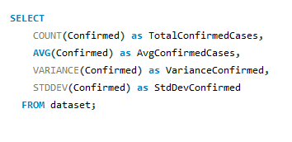

How corona virus spread out with respect to confirmed case (E.g.: total confirmed cases, their average, variance & STDEV)
Case Distribution Analysis

Slide 16
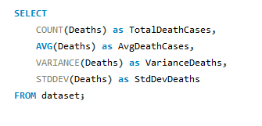

How corona virus spread out with respect to death case per month (E.g.: total confirmed cases, their average, variance & STDEV)
Death Case Analysis

Slide 17
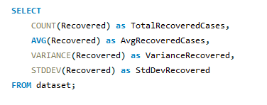

How corona virus spread out with respect to recovered case (E.g.: total confirmed cases, their average, variance & STDEV)
Recovery Analysis

Slide 18
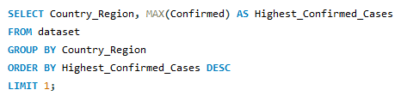

Country having highest number of the Confirmed case
Country Analysis

Slide 19
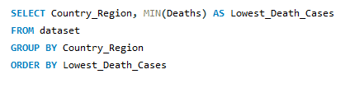
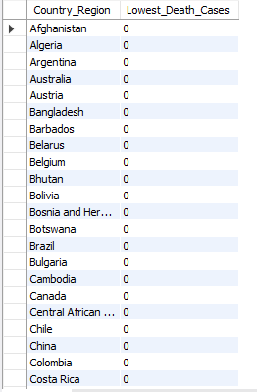
Country having lowest number of the death case
Country Analysis

Slide 20
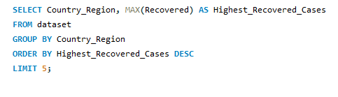
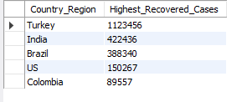
Top 5 countries having highest recovered case
Country Analysis

Slide 21
Conclusion
These findings can aid in understanding the patterns and trends of the CORONA VIRUS pandemic, allowing for better preparedness and response strategies in combating the spread of the virus.
The analysis provides valuable insights for policymakers, healthcare professionals, and researchers to address the impact of the pandemic on a global scale and implement targeted interventions to mitigate the effects of the virus.
By leveraging data-driven insights, governments and organizations can make informed decisions to prioritize resources, allocate support, and implement effective measures to control the spread of CORONA VIRUS and ensure public health safety.

Slide 22
THANK YOU

